Slide 1
HOTEL BOOKING
A Data Analysis Journey

Slide 2
PROBLEM STATEMENT
In recent years , City Hotel and Resort hotels faces significant challenges due to frequent reservation cancellations, which impact revenue predictability, resource allocation, and customer satisfaction. Understanding the factors that influence booking behavior—particularly cancellations—is critical for improving operational efficiency and financial performance.
This project aims to analyze hotel booking data from city and resort hotels to:
Identify patterns and trends associated with cancellations.
Examine the impact of market segments, seasonality, and hotel type on booking outcomes.
Explore average daily rate (ADR) variations over time.
Extract actionable insights that can inform strategic decisions in pricing, customer targeting, and policy setting.
The ultimate objective is to provide data-driven recommendations that help minimize cancellations, improve revenue management, and enhance customer satisfaction in the competitive hotel industry.

Slide 3
ASSUMPTIONS
The dataset accurately reflects real hotel booking activity.
Dropping missing values does not significantly bias the analysis.
ADR values above 4000 are considered outliers and excluded.
The is_canceled field reliably indicates cancellation status.
Monthly trends are assumed to represent typical seasonality.
Customer behavior is stable during the dataset period.
Market segment labels are accurate and well-defined.
No major external events affected booking patterns.

Slide 4
Setting the Scene
Our dataset was a treasure trove of information, containing details about bookings from two types of hotels: City Hotel and Resort Hotel. The data included everything from the number of guests to reservation statuses and even the daily rates paid.
Before diving into insights, we performed essential data cleaning. We explored the dataset, identified missing values, and decided to drop the heavily incomplete company and agent columns. Rows with any remaining missing data were also removed. We transformed reservation_status_date into a datetime format, which became crucial for time-based trends, and filtered out extreme outliers (like ADRs over 4000) to maintain focus on typical patterns.

Slide 5
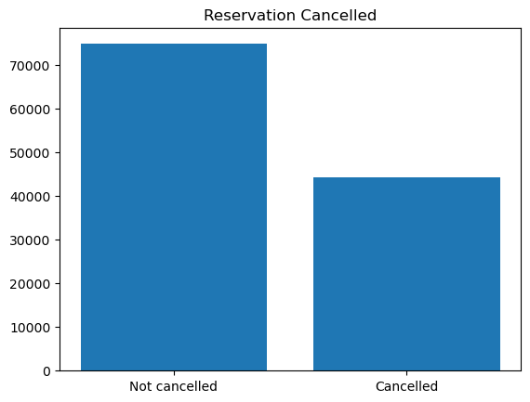
Unveiling Pattern
We first examined cancellation trends. Roughly 37% of bookings were cancelled, a surprisingly high number that was clearly illustrated in a bar chart comparing cancelled and non-cancelled bookings. When breaking this down by hotel type, City Hotels showed a higher cancellation rate than Resort Hotels, possibly reflecting their appeal to business travelers who may have less predictable schedules.

Slide 6
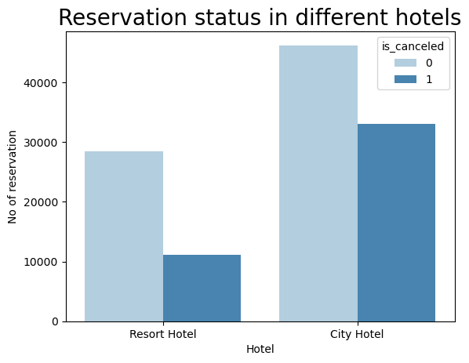
A key aspect of our analysis focused on the reservation status in different hotels. We examined how booking outcomes—whether reservations were honored, canceled, or marked as no-shows—varied between City and Resort Hotels. A count plot helped us visualize this: City Hotels had a higher proportion of canceled bookings compared to Resort Hotels, while Resort Hotels showed a stronger ratio of completed stays. This pattern suggests that City Hotels, likely catering to more business travelers, face greater volatility in bookings. The data highlighted that understanding these differences is crucial for tailoring cancellation policies and forecasting occupancy more accurately.

Slide 7
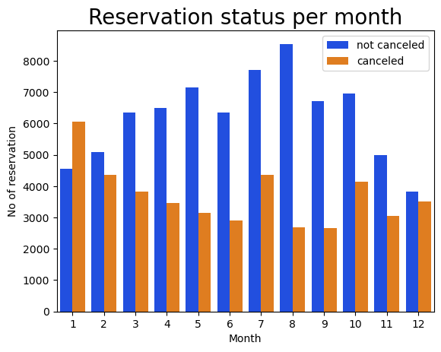
SEASONALITY
We also investigated the reservation status per month to understand seasonal patterns in cancellations and completions. By grouping data by month and reservation status, we observed clear trends: cancellations tended to peak in the early part of the year (January to March), while completed stays surged during the summer months, especially in July and August. This analysis, visualized through a stacked bar chart, highlighted how seasonality impacts not just bookings but also their outcomes, offering valuable insights for hotel planning and staffing.

Slide 8
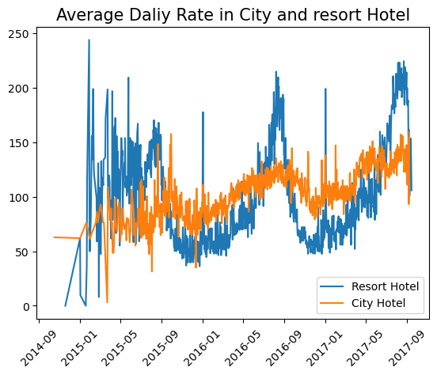
TIME TRAVEL THROUGH DATA
Our analysis of the Average Daily Rate (ADR) over time revealed fascinating patterns. A line chart illustrated how Resort Hotels experienced sharp price spikes during holidays and vacation seasons, while City Hotels had steadier but distinct cycles, likely tied to business travel peaks. These insights suggest different pricing strategies may be needed for each hotel type.

Slide 9
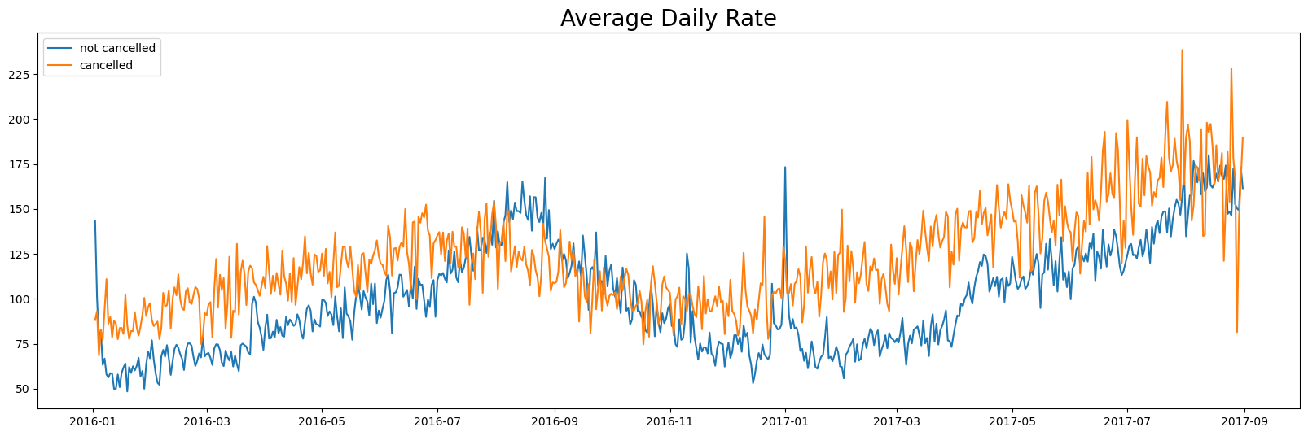
We deepened our analysis of the Average Daily Rate (ADR) to understand its variation across different factors. By segmenting the data by hotel type, reservation status, and even lead time, we found notable insights. Resort Hotels commanded higher ADRs during peak seasons, especially in July and August, while City Hotels maintained relatively stable ADRs with modest rises during business-heavy months. Additionally, canceled bookings tended to have slightly lower ADRs, suggesting price sensitivity may influence cancellation behavior. This multi-faceted ADR analysis was visualized through line and box plots, offering a rich perspective on pricing dynamics.

Slide 10
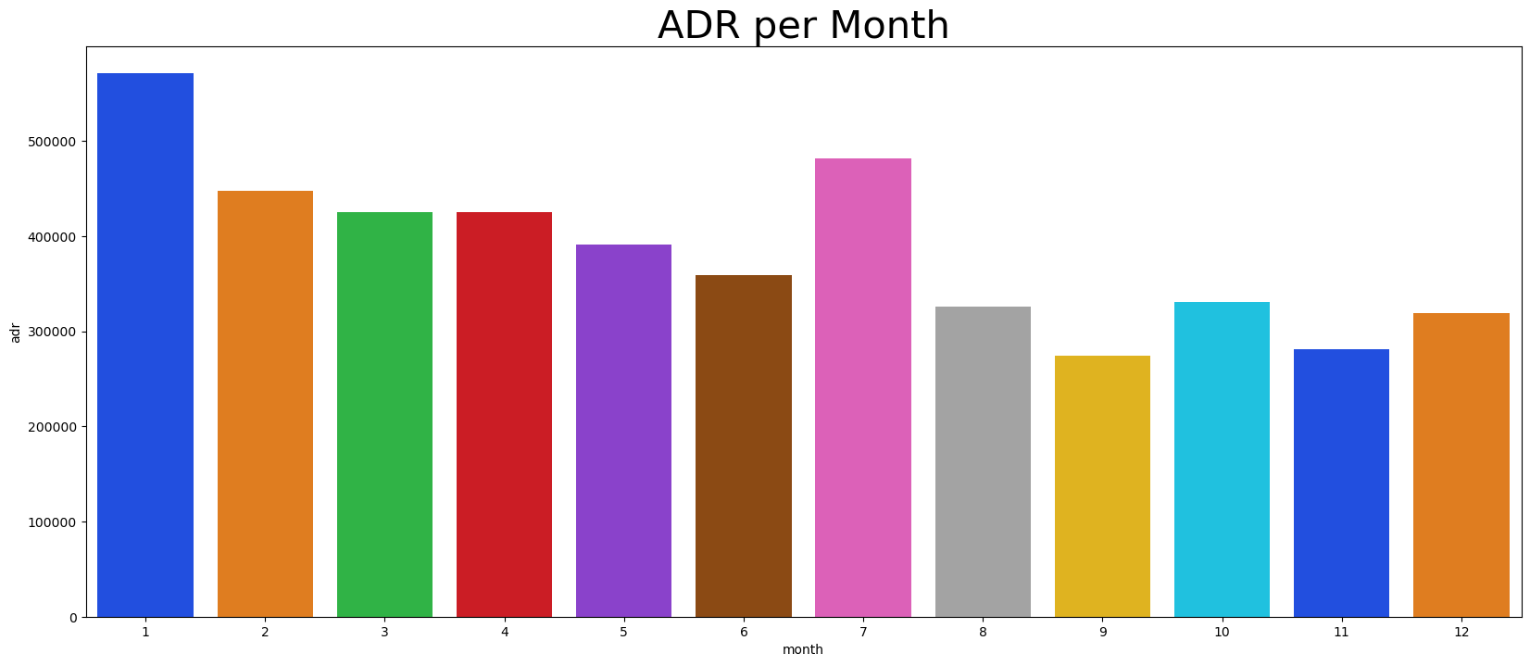
RESERVATION STATUS
To add more context, we analyzed booking trends by month and market segment. A bar plot showed that peak booking months were July and August, especially for Resort Hotels, underscoring their draw during summer vacations. City Hotels, meanwhile, maintained a more consistent flow year-round.

Slide 11
SUGGESTIONS
Dynamic Pricing: Implement flexible pricing strategies, increasing rates during peak demand (summer for Resort Hotels, business-heavy months for City Hotels) and offering discounts in low-demand periods.
Cancellation Policy Review: For City Hotels, consider introducing stricter cancellation policies or incentives for non-refundable bookings to manage high cancellation rates.
Marketing Campaigns: Focus marketing efforts on domestic travelers, especially in top source countries like Portugal, UK, and France, while also targeting international markets in the off-season.
Seasonal Staffing: Adjust staffing levels to match seasonal demand—ramping up in July and August for Resort Hotels, and maintaining steady staff for City Hotels year-round.
Lead Time Monitoring: Use lead time data to predict demand and adjust inventory and promotions proactively.
Customer Segmentation: Develop targeted offers for leisure vs. business travelers to cater to their distinct needs and behaviors.

